Slide 1
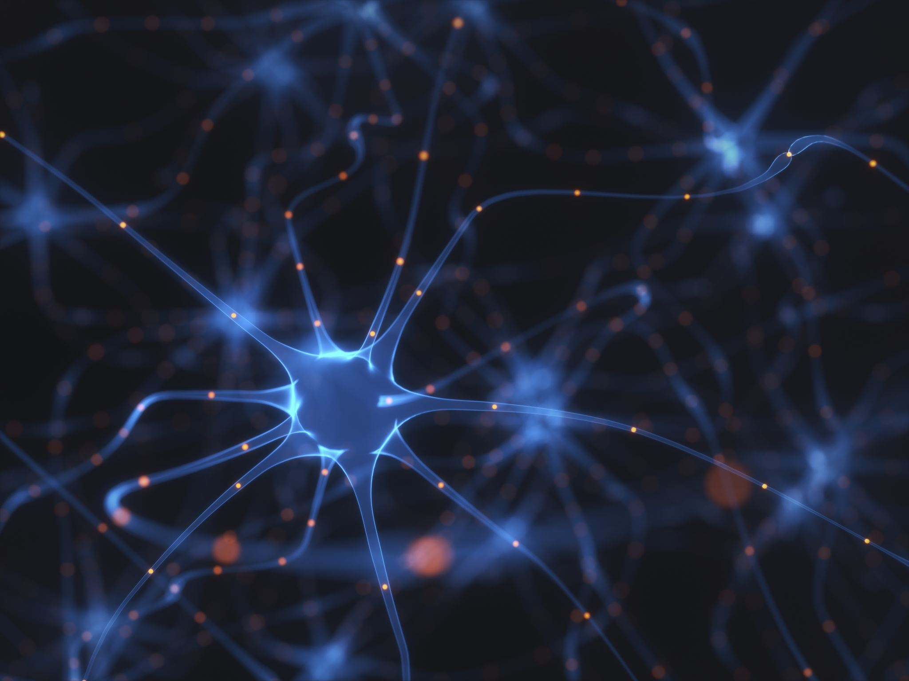
Essentials of Discriminatory AI: Convolutional Neural Networks
Namig Abbasov
Data Science and Analytics, Hayden Library, ASU

Slide 2
Discriminatory AI vs Generative AI: Goal
Discriminatory AI
Model entire data distribution
Capture conditional probability distribution of labels based on input
Generative AI Models
Understand underlying distribution of data
Generate content resembling data
Notes:
https://www.plainconcepts.com/discriminative-ai-vs-generative-ai/

Slide 3
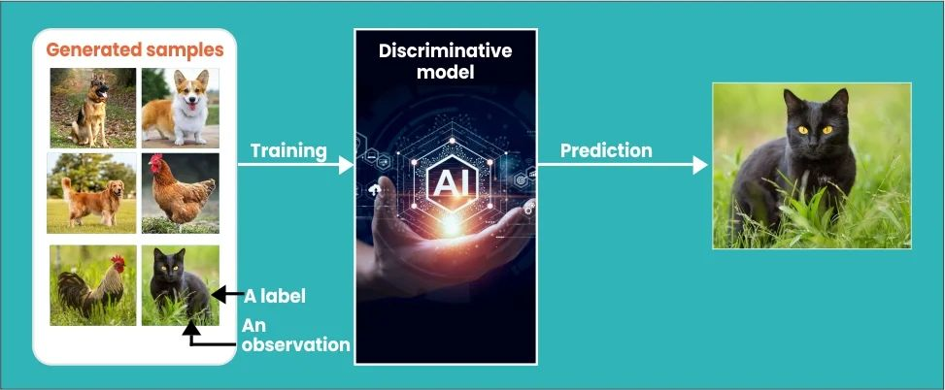
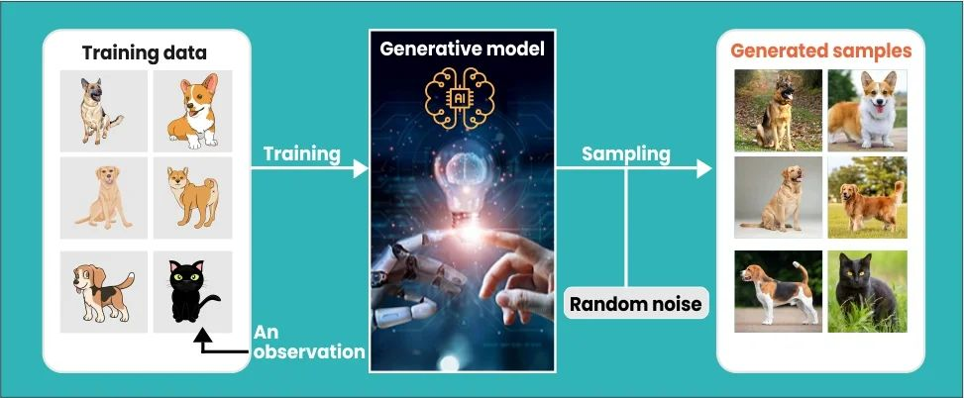

Slide 4
Discriminatory AI vs Generative AI: Examples
Discriminatory AI
Support vector machines
k-nearest neighbor (KNN)
Decision Trees
Random Forest
Generative AI
Bayesian network
Autoregressive model
Generative adversarial network (GAN)

Slide 5
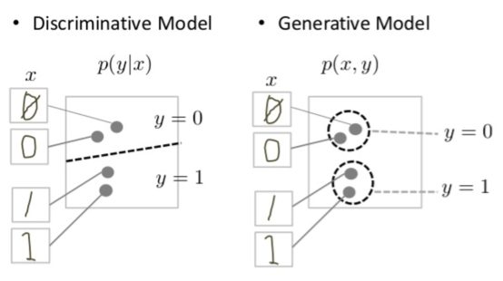
Discriminative vs. Generative
Notes:
https://developers.google.com/machine-learning/gan/generative

Slide 6
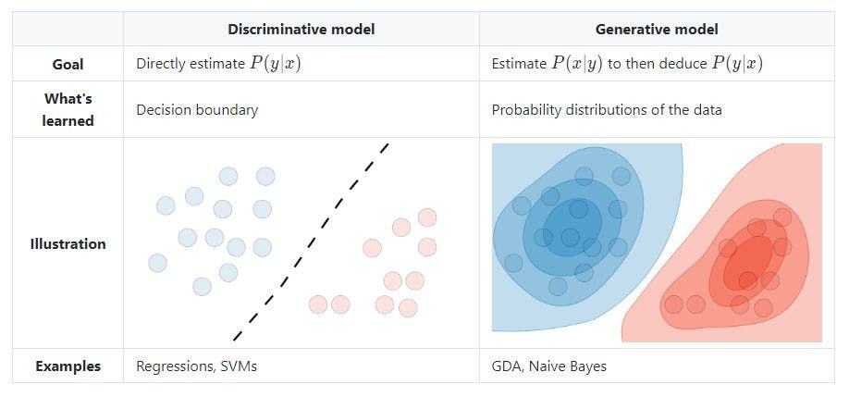
Discriminatory AI vs Generative AI
Notes:
https://www.turing.com/kb/generative-models-vs-discriminative-models-for-deep-learning

Slide 7
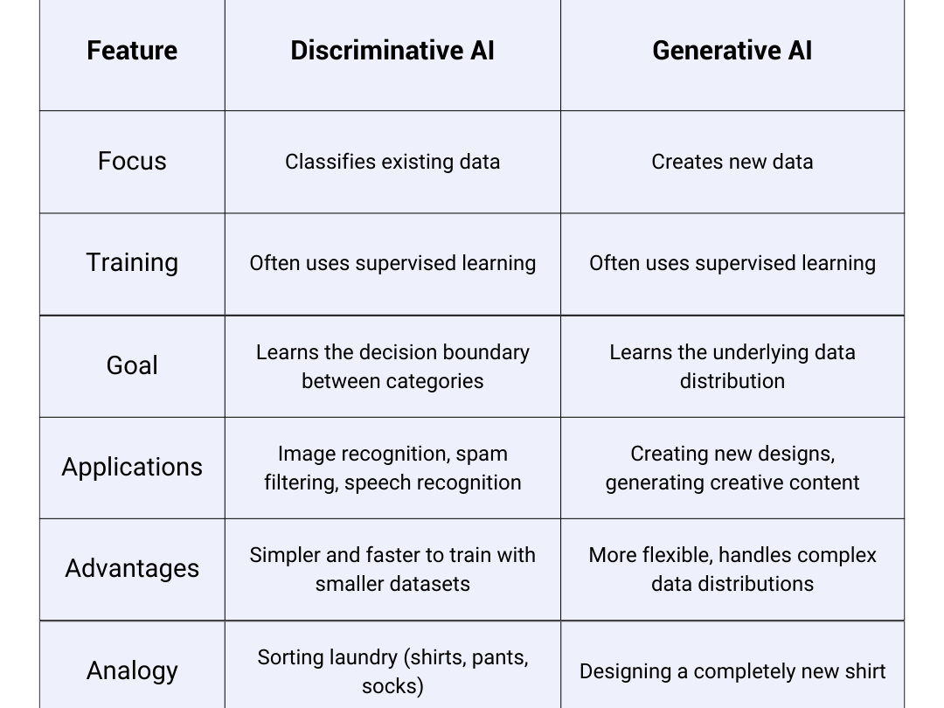

Slide 8
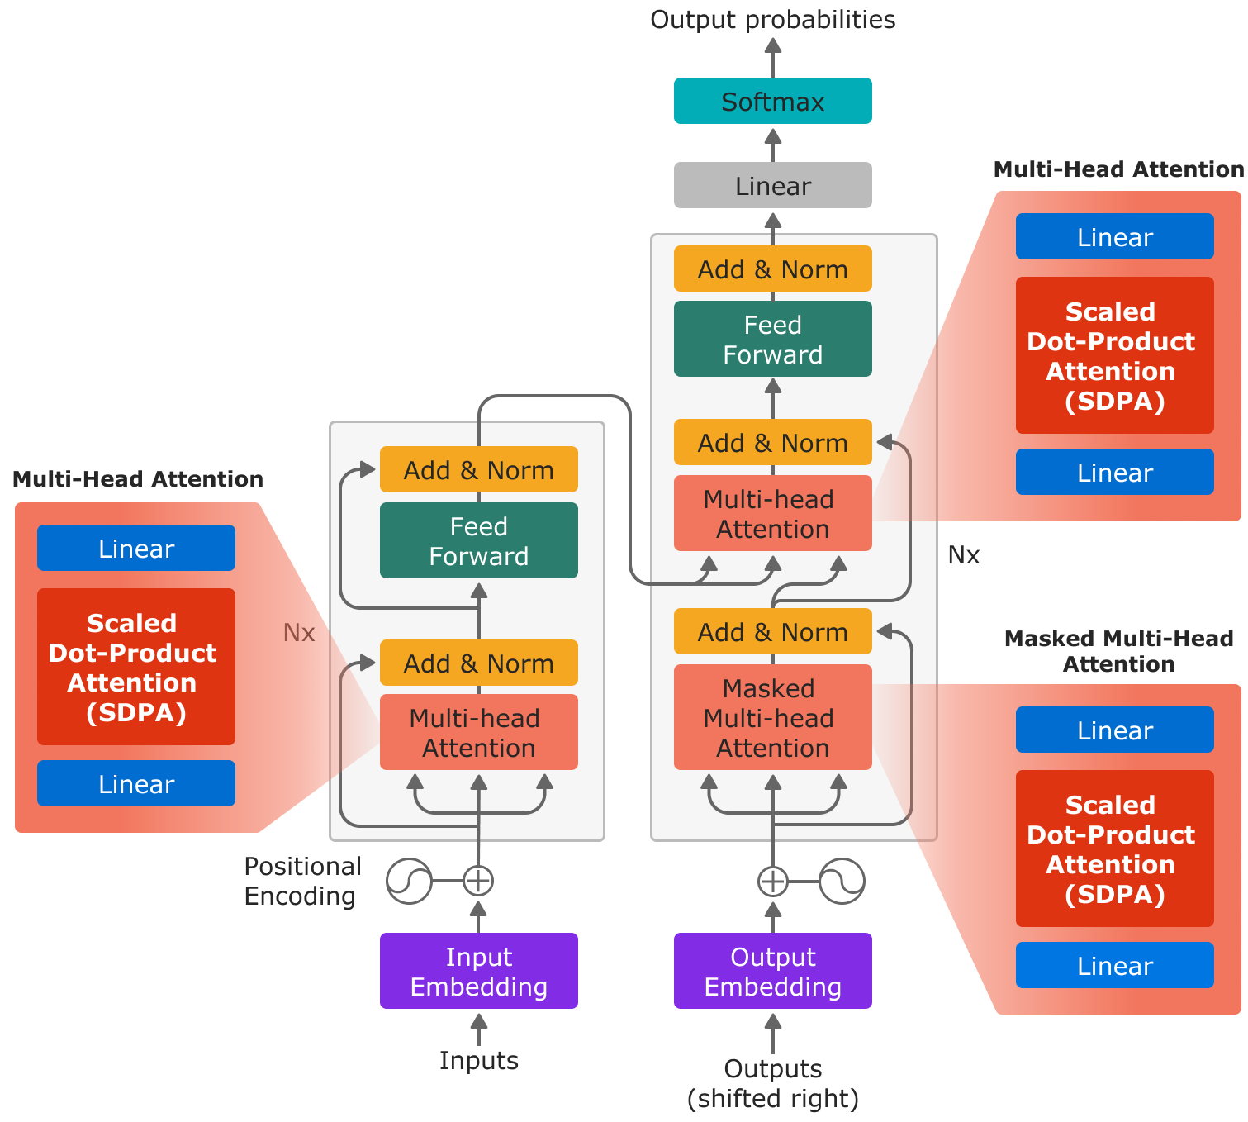
Are Transformer Models Generative or Discriminatory?

Slide 9
CNNs as Discriminatory AI
Focus on Classification, Not Generation
Objective to Learn Decision Boundaries
Conditional Probability, Not Joint Probability
Architecture Built for Feature Extraction
Training Goal: Minimizing Classification Error

Slide 10
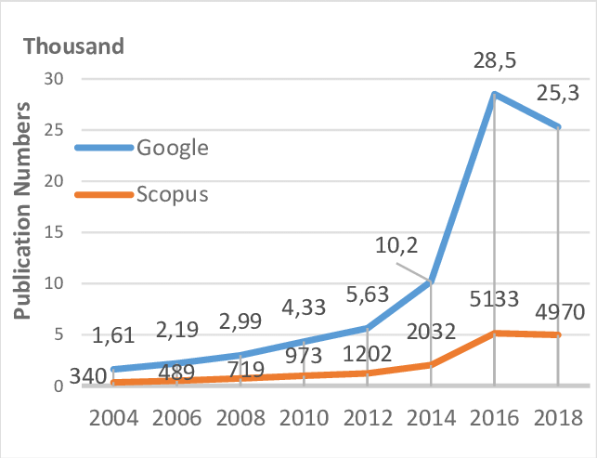
Applications of CNNs
Image Classification
Image Segmentation
Disease Detection
Medical
Agriculture

Slide 11
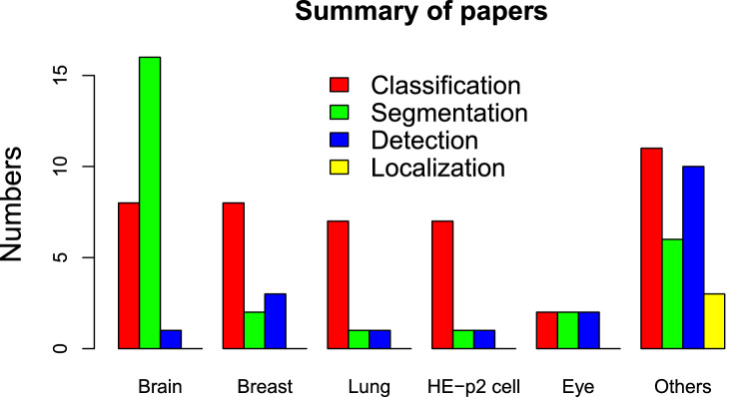

Slide 12
Locating CNNs in Neural Network Types
Perceptrons
Feedforward Neural Networks
Convolutional Neural Networks
Recurrent Neural Networks (RNNs)
Generative Adversarial Network (GAN)
Transformer Architecture

Slide 13
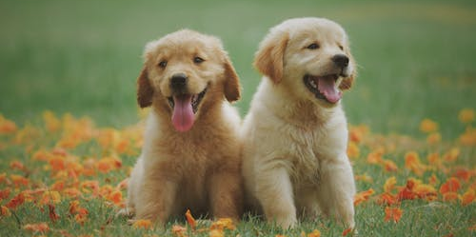
256×256×256=16,777,216 colors
pure red (255,0,0), green (0,255,0), or blue (0,0,255)
purple (128,0,128), teal (0,128,128), and yellow (255,255,0)

Slide 14
Convolutions in CNNs
Convolutional filters (kernels)
Applying a filter to an image

Slide 15
Overview of CNN Architecture
Convolution
Pooling
Fully connected layers
ReLU
Flattening
Kernels(Filters) with Strides
Feature Mapping
Max pooling
Average Pooling

Slide 16
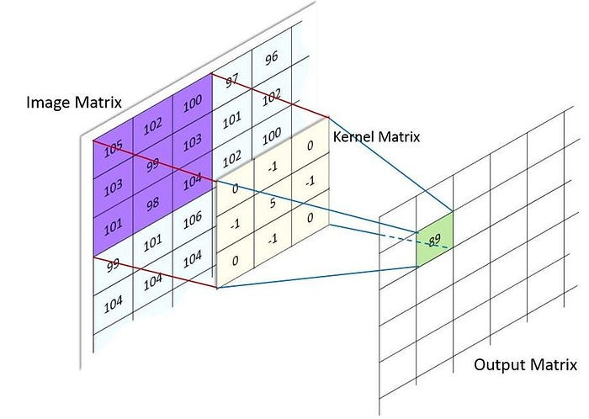

Slide 17
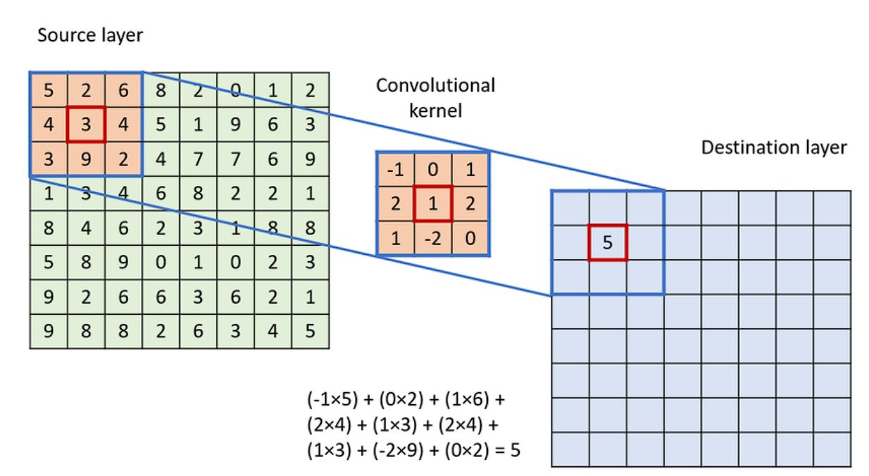

Slide 19
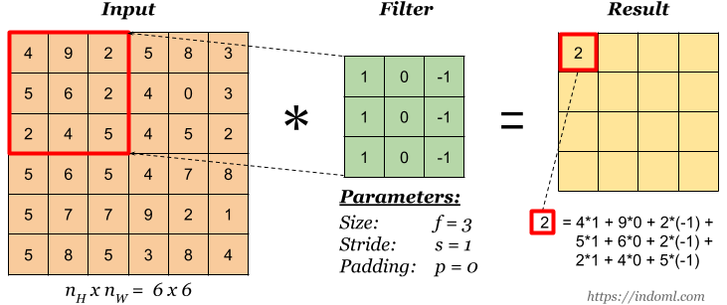

Slide 20
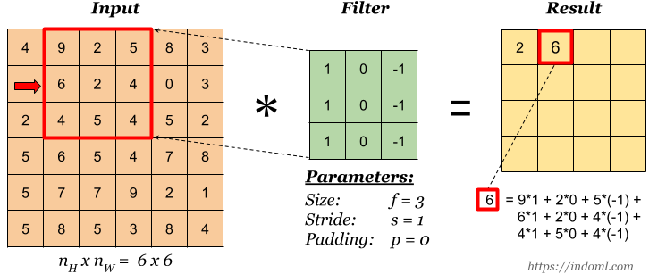

Slide 21
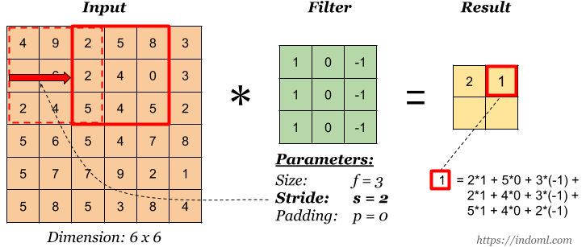

Slide 22
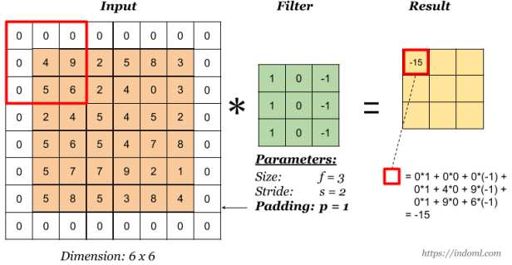

Slide 23
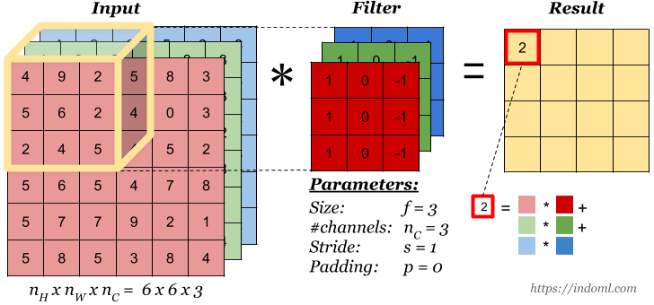

Slide 24
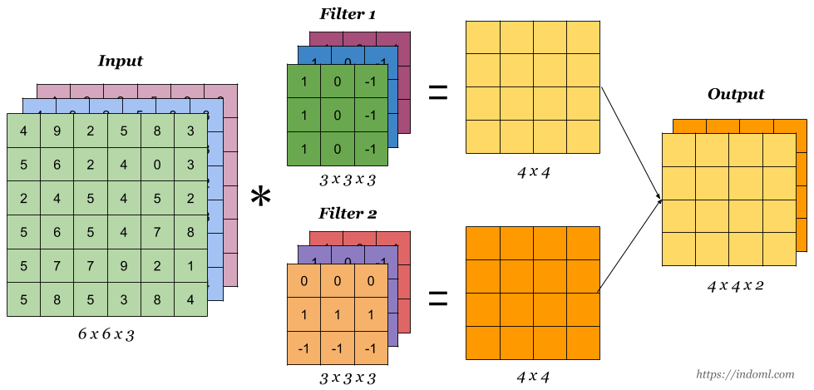
Channels

Slide 25
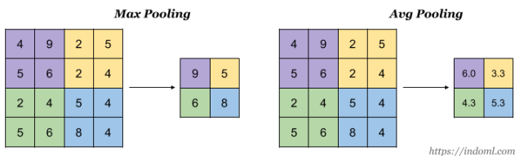
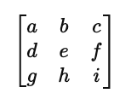

Pooling and Flattening

Slide 26
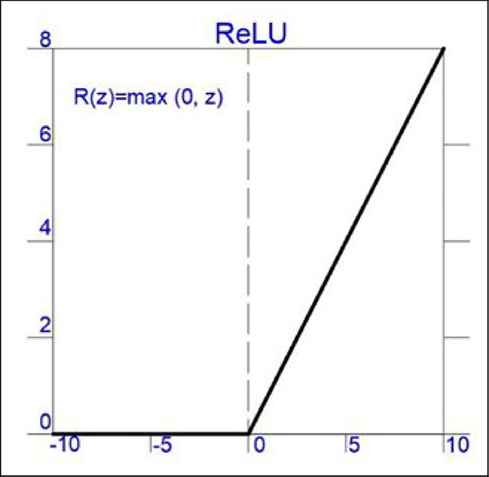
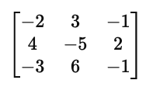
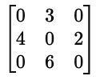
Understanding Relu
Notes:
https://www.researchgate.net/figure/Activation-function-ReLu-ReLu-Rectified-Linear-Activation_fig2_370465617

Slide 27
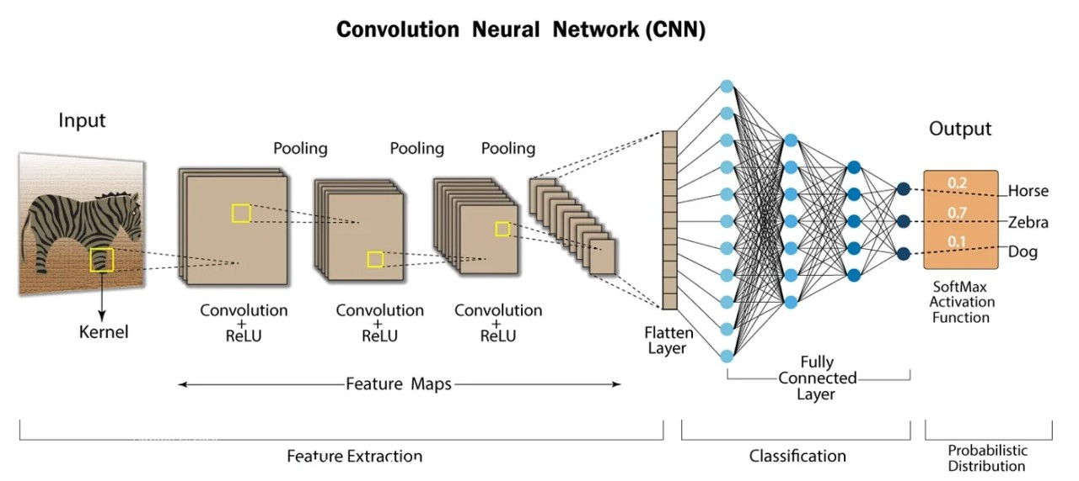

Slide 28
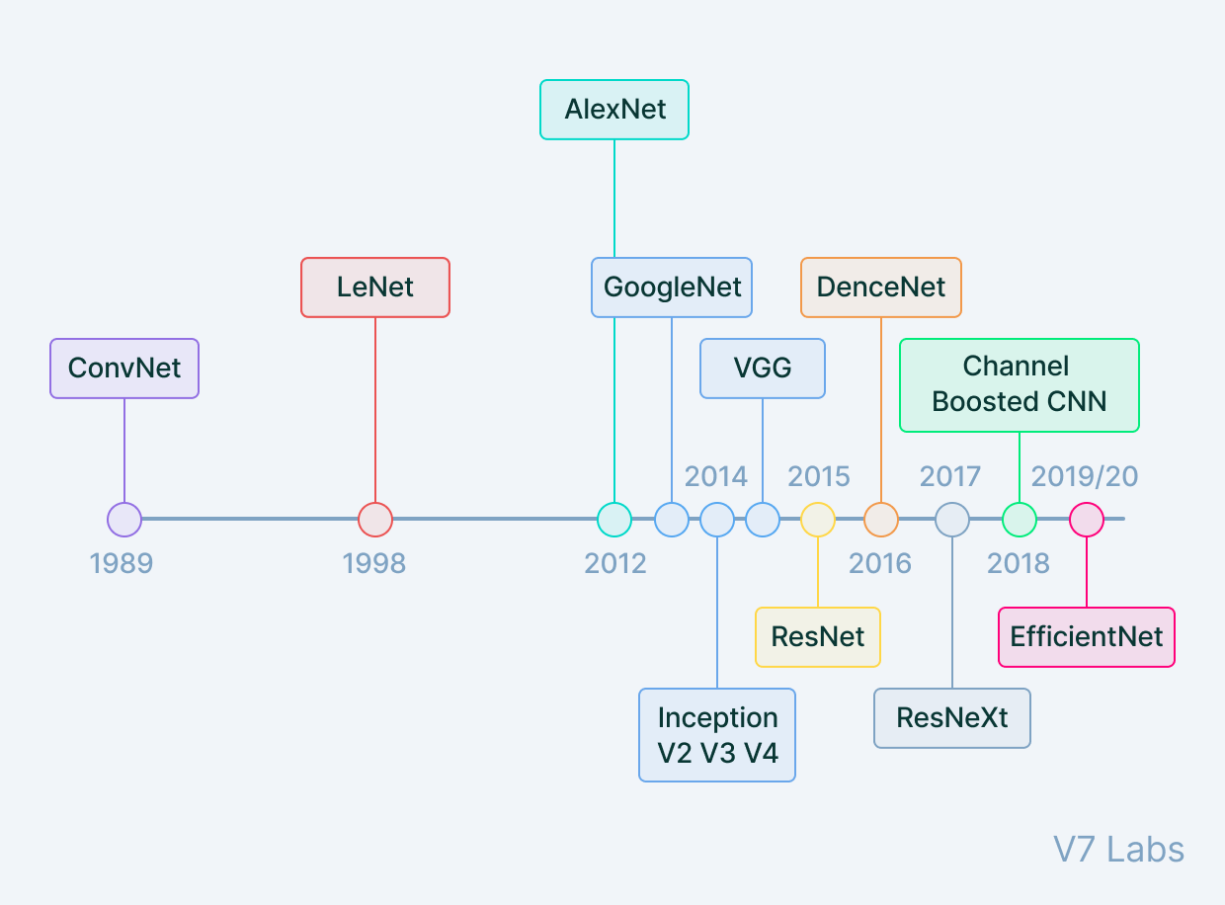
Evolution of CNN Architectures

Slide 29
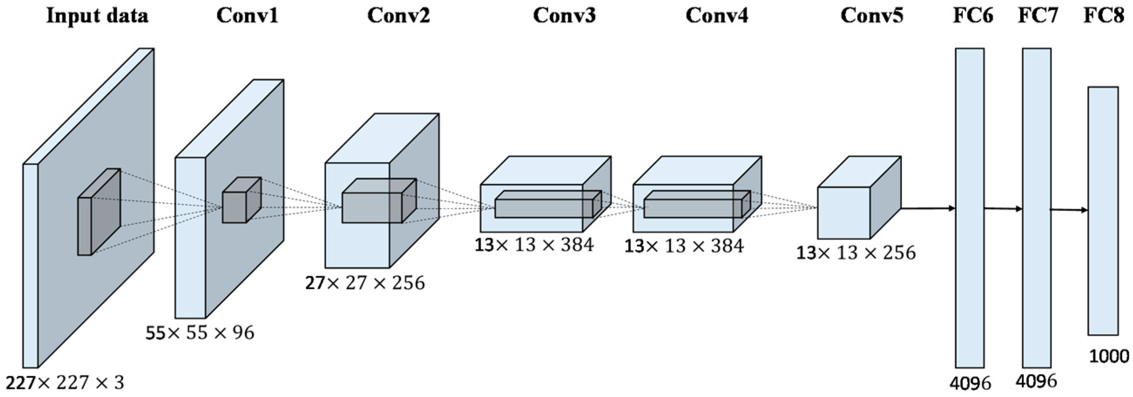
AlexNet

Slide 30
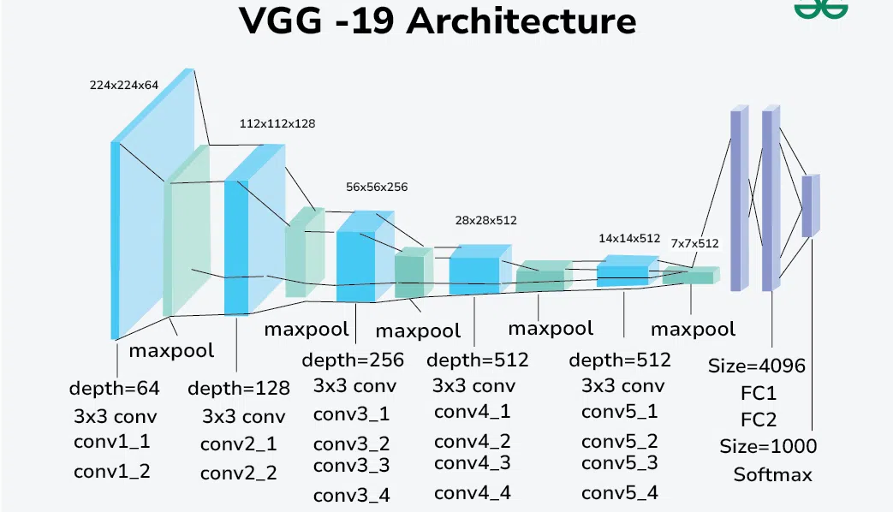
VGGNet
Deeper architecture with smaller filters (3x3)

Slide 31
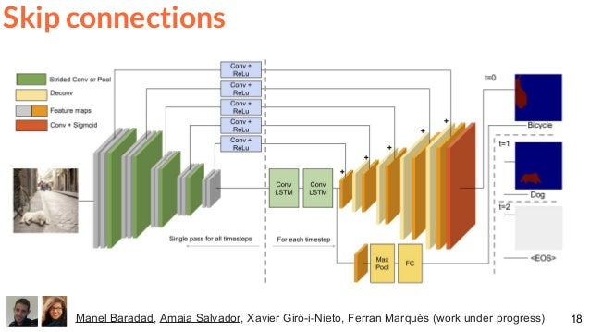

Slide 32
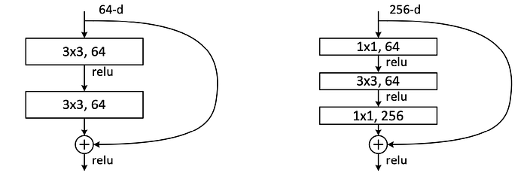
Skip Connections

Slide 33
Transfer Learning in CNNs
Using pre-trained models for new classification tasks
Fine-tuning for better performance on smaller datasets

Slide 34
Emerging Trends in CNNs
Introduction to Transformer-based architectures (Vision Transformers)
Hybrid models combining CNN and Transformers

